Slide 1
Project PaceX
By chamber n adam

Slide 2
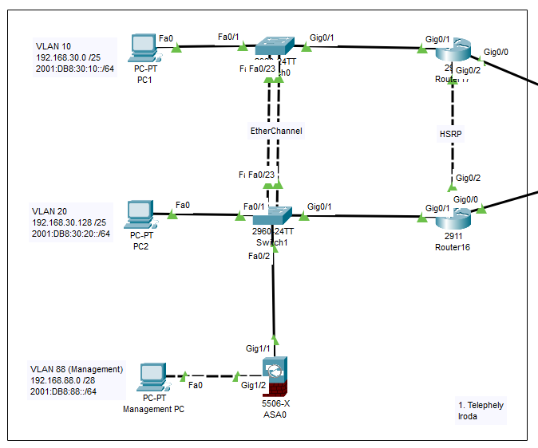
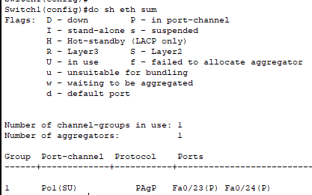
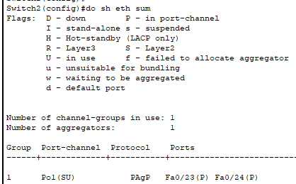
1. Telephely
Eszköz | VLAN | IPv4 | IPv6
PC1 | 10 | 192.168.30.0/25 | 2001:db8:30:10::/64
PC2 | 20 | 192.168.30.128/25 | 2001:db8:30:20::/64
PC3 | 88 | 192.168.88.0/28 | 2001:db8:30:80::/64
Router 1 | 10 20 88 | 192.168.30.2 192.168.30.130 192.168.88.1 | 2001:db8:30:10::1/64 2001:db8:30:20::1/64 2001:db8:88::1 /64
Router 2 | 10 20 88 | 192.168.30.3 192.168.30.131 192.168.88.2 | 2001:db8:30:10::2/64 2001:db8:30:20::2/64 2001:db8:88::2 /64
HSRP | 10 20 | 192.168.30.1 192.168.30.129
Switch 1 | 88 | 192.168.88.3
Switch 2 | 88 | 192.168.88.4
IP címzés & VLANok EtherChannel HSRP VPN ASA Portsecurity

Slide 3
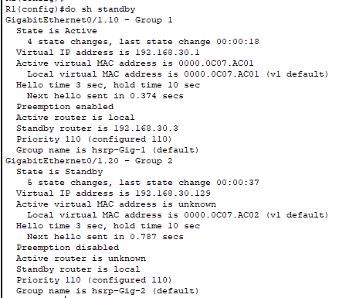
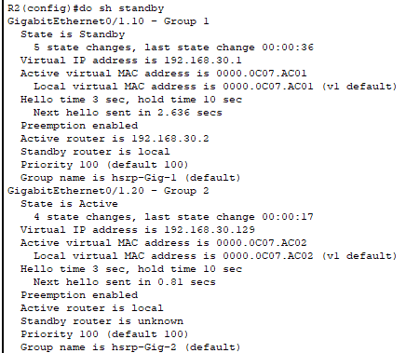
1. Telephely
Eszköz | VLAN | IPv4 | IPv6
PC1 | 10 | 192.168.30.0/25 | 2001:db8:30:10::/64
PC2 | 20 | 192.168.30.128/25 | 2001:db8:30:20::/64
PC3 | 88 | 192.168.88.0/28 | 2001:db8:30:80::/64
Router 1 | 10 20 88 | 192.168.30.2 192.168.30.130 192.168.88.1 | 2001:db8:30:10::1/64 2001:db8:30:20::1/64 2001:db8:88::1 /64
Router 2 | 10 20 88 | 192.168.30.3 192.168.30.131 192.168.88.2 | 2001:db8:30:10::2/64 2001:db8:30:20::2/64 2001:db8:88::2 /64
HSRP | 10 20 | 192.168.30.1 192.168.30.129
Switch 1 | 88 | 192.168.88.3
Switch 2 | 88 | 192.168.88.4
IP címzés & VLANok EtherChannel HSRP VPN ASA Portsecurity

Slide 4
1. Telephely
Eszköz | VLAN | IPv4 | IPv6
PC1 | 10 | 192.168.30.0/25 | 2001:db8:30:10::/64
PC2 | 20 | 192.168.30.128/25 | 2001:db8:30:20::/64
PC3 | 88 | 192.168.88.0/28 | 2001:db8:30:80::/64
Router 1 | 10 20 88 | 192.168.30.2 192.168.30.130 192.168.88.1 | 2001:db8:30:10::1/64 2001:db8:30:20::1/64 2001:db8:88::1 /64
Router 2 | 10 20 88 | 192.168.30.3 192.168.30.131 192.168.88.2 | 2001:db8:30:10::2/64 2001:db8:30:20::2/64 2001:db8:88::2 /64
HSRP | 10 20 | 192.168.30.1 192.168.30.129
Switch 1 | 88 | 192.168.88.3
Switch 2 | 88 | 192.168.88.4
IP címzés & VLANok EtherChannel HSRP VPN ASA Portsecurity

